Slide 1
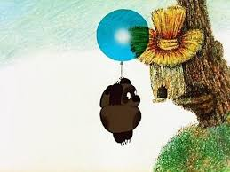

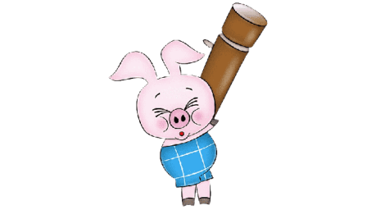
Do or Does?

Slide 2











Do
Don’t
Does
Does
____Winnie like honey?

Slide 3
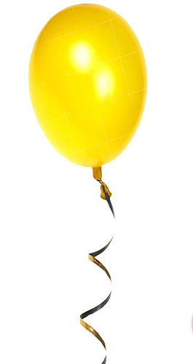

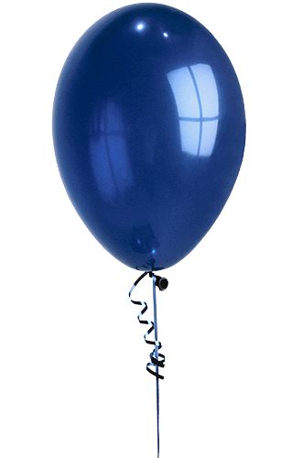





don’t
do
does
does
Where Winnie ____buy huney?

Slide 4





Do
Does
Don’t
Do
__bears eat honey for breakfast?

Slide 5






Don’t
Do
Does
Do
__little pigs eat honey soup?

Slide 6


